Slide 1

The Power of SPA
#PGGD26 – 23/04/2015
Mónica Rodrigues
monica85rodrigues@gmail.com

Slide 2







Since 2010
Me?
Mónica Rodrigues

Slide 3
Contents
Problem
Solution
Motivations
Considerations
Sample of SPA
Demos
References

Slide 4
Problem
The user wants a central place to view or take actions on most or all content so they don’t have to waste time navigating between pages.

Slide 5
Solution
Use modern web development techniques to build a single-page app that doesn’t need to reload itself as the user browses through it.
SPA
Single Page Application

Slide 6
Motivations
The 3 Rs
Reach
Web app can be accessible on different platforms and devices
Responsive
Web app needs to be very responsive to different resolutions
Round Trip
Web app does not require many round trips between client and server

Slide 7
Motivations
Best user experience
Separation of responsibilities of client and server
Offline Web applications

Slide 8
Considerations
The first time that the application load is slow
Security
How much it costs to make an offline application? It is possible?

Slide 9
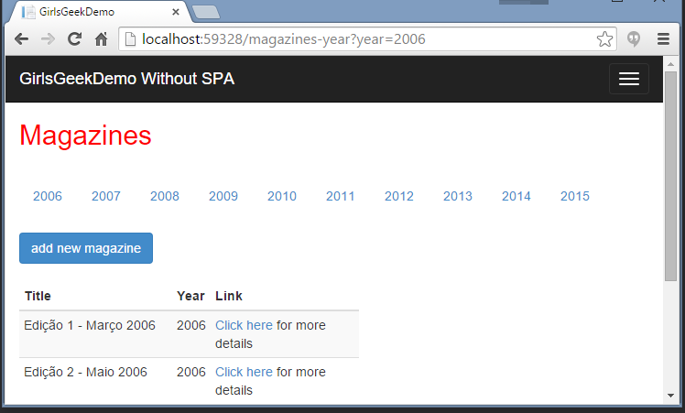

No SPA
Consulta página
Renderiza página
Retorna página renderizada

Slide 10
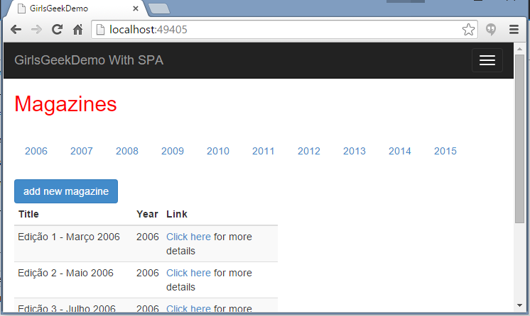
SPA
Processa e manipula
DOM
Requer dados
Retorna dados

Slide 11



Some Javascript Frameworks

Slide 12







Samples of SPA

Slide 13
Demos

Slide 14
Referências
Angular VS Knockout http://blog.scottlogic.com/2014/07/30/spa-angular-knockout.html [2014]
Angular https://angularjs.org/
Knockout.js http://knockoutjs.com/
Backbone.js http://backbonejs.org/
http://singlepageappbook.com/goal.html

Slide 15


